Slide 1


My Portfolio: Building with ReactJS
Crafting a professional and visually appealing portfolio website using the power of ReactJS, a popular JavaScript library for building user interfaces.
by PRITESH SAWANT

Slide 2

Introduction to ReactJS
ReactJS is a powerful, open-source JavaScript library for building user interfaces. Developed and maintained by Facebook, ReactJS has gained immense popularity among web developers for its efficient and component-based approach to building dynamic web applications.

Slide 3
Choosing and Setting Up ReactJS for My Portfolio
Setting up the Development Environment
Evaluating ReactJS
Assess the benefits of using ReactJS for a portfolio website, such as its component-based architecture, virtual DOM, and robust ecosystem of libraries and tools.
Install Node.js, npm, and create a new React project using a tool like Create React App. Configure the project with necessary dependencies and development tools.
Structuring the Project
Choosing a CSS Framework
Organize the project's file structure, separating components, pages, and other relevant directories. Establish a consistent naming convention and folder hierarchy.
Evaluate different CSS frameworks, such as TailwindCSS or Styled Components, to streamline the styling process and create a visually appealing portfolio.

Slide 4

Key Features of ReactJS
1
Component-based Architecture: ReactJS follows a component-based approach, allowing developers to create reusable UI elements that can be easily combined to build complex user interfaces.
Virtual DOM: ReactJS uses a virtual Document Object Model (DOM) to efficiently update and render changes, resulting in fast and responsive web applications.
Unidirectional Data Flow: ReactJS enforces a unidirectional data flow, where data moves in a single direction, making it easier to understand and reason about application state.
Lifecycle Methods: ReactJS provides a set of lifecycle methods that allow developers to control the different stages of a component's lifecycle, enabling more fine-grained control over the application's behavior.
Robust Ecosystem: ReactJS benefits from a large and active community, providing access to a wide range of libraries, tools, and resources that can be leveraged to build complex web applications.

Slide 5
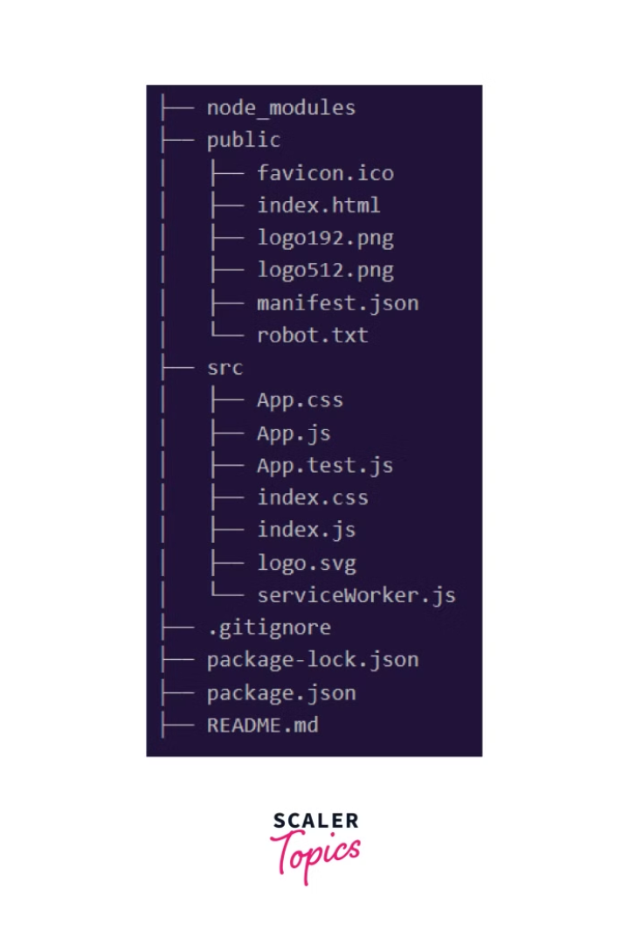
Initial Setup and API Integration for ReactJS Portfolio with TailwindCSS
To begin building a visually stunning portfolio with ReactJS, we'll set up the development environment and integrate powerful styling capabilities using TailwindCSS. This strategic combination empowers developers to create responsive, user-friendly interfaces while maintaining code organization and performance.

Slide 6
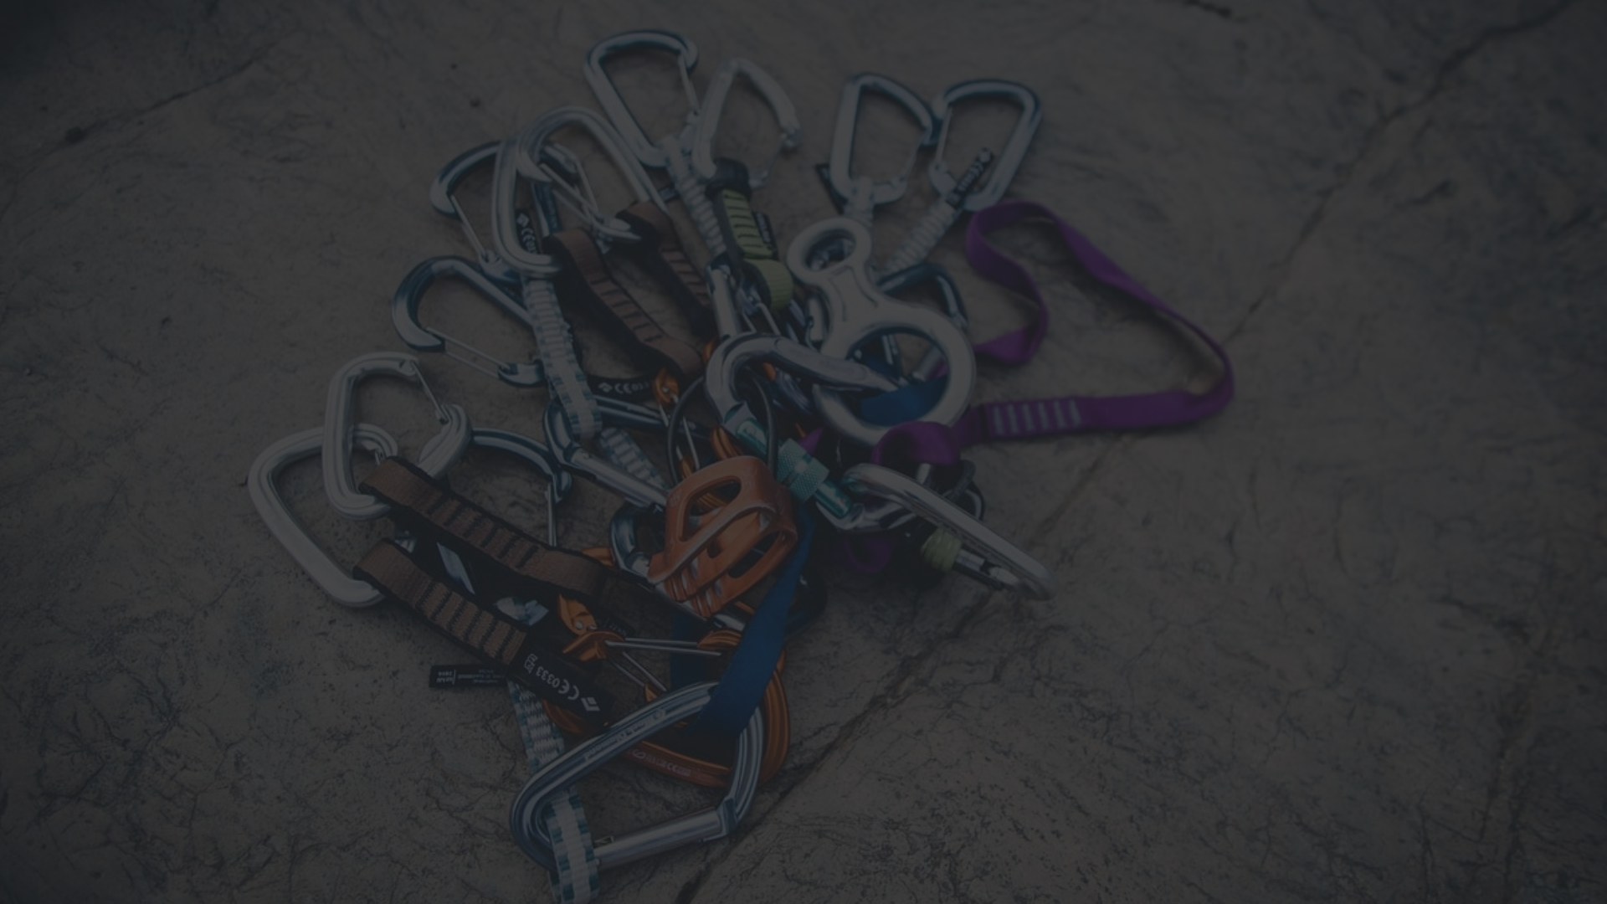
Hooks in ReactJS
Hooks are a powerful feature introduced in ReactJS 16.8 that allow functional components to utilize state and lifecycle methods. They enable developers to write more concise and reusable code, improving the overall maintainability and testability of ReactJS applications.
1
State Hooks: Hooks like useState allow functional components to manage internal state, making them more dynamic and interactive.
Effect Hooks: The useEffect hook provides a way to handle side effects, such as data fetching, subscriptions, and manual DOM manipulations, within functional components.
Custom Hooks: Developers can create their own reusable custom hooks, encapsulating complex logic and sharing it across multiple components, promoting code reuse and modularity.

Slide 7
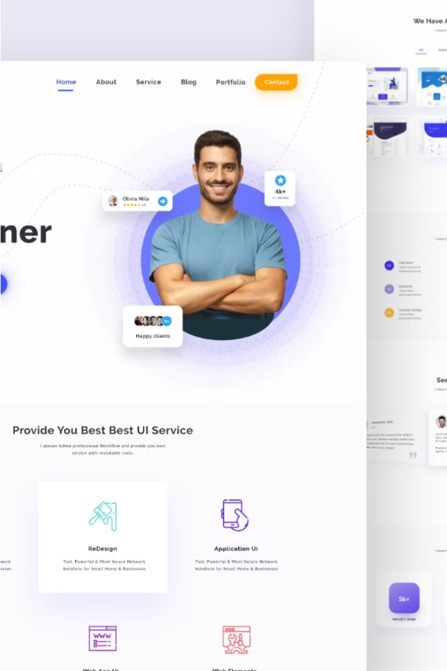
Building a Portfolio with ReactJS and TailwindCSS
Crafting a professional, visually appealing portfolio website with ReactJS and TailwindCSS offers numerous benefits. ReactJS's component-based architecture enables efficient development, modularization, and scalability, while its robust ecosystem provides access to a wide range of libraries and tools. TailwindCSS's utility-first approach streamlines the styling process, allowing developers to quickly design responsive layouts and customize styles to their needs.
This project serves as a testament to the powerful capabilities of ReactJS and TailwindCSS in creating engaging user interfaces. By leveraging these technologies, developers can maintain code quality, improve performance, and provide a comprehensive guide for others embarking on similar endeavors.

Slide 8
Integrating APIs and Data Fetching
To create a dynamic and data-driven portfolio website with ReactJS, integration with external APIs is essential. This allows developers to fetch and display real-time information, such as project details, work samples, and client testimonials, directly from their data sources.
1
Utilizing Fetch API or Axios: Leverage built-in or third-party libraries to make HTTP requests and fetch data from APIs in a clean and efficient manner.
Handling Asynchronous Data: Manage asynchronous data fetching using ReactJS's useEffect hook and state management to ensure a smooth and responsive user experience.
Caching and Optimizing Data Fetching: Implement caching mechanisms and optimize data fetching strategies to improve performance and reduce unnecessary API requests.
Error Handling and Fallbacks: Implement robust error handling and provide fallback solutions to gracefully handle API failures or connectivity issues.

Slide 9
Deploying ReactJS Applications
Build Optimization
Continuous Deployment
Optimize the React application for production by running build scripts to create a minified, optimized bundle. This ensures faster load times and improved performance for end-users.
Automate the deployment process by setting up continuous integration and continuous deployment (CI/CD) pipelines. This ensures that updates are quickly and reliably pushed to production.
1
2
3
Hosting Platforms
Choose a reliable hosting platform, such as Netlify, Vercel, or AWS S3, that seamlessly integrates with React and provides easy deployment workflows.

Slide 10
Conclusion and Next Steps
In conclusion, building a portfolio website with ReactJS and TailwindCSS has proven to be a powerful and rewarding endeavor. By leveraging the strengths of these technologies, developers can create visually stunning, responsive, and scalable web experiences that showcase their talents and achievements.
As you move forward, consider exploring additional features and functionalities to enhance your portfolio, such as integrating video or audio clips, implementing a content management system (CMS), or exploring advanced animation techniques. Continuous learning and embracing new tools and trends in the ever-evolving web development landscape will ensure your portfolio remains fresh, engaging, and a true reflection of your growing expertise.

Slide 11

Thank You

